Slide 1

CHAPTER 1
SPEAKING MATHEMATICALLY
Copyright © Cengage Learning. All rights reserved.

Slide 2

1.3
The Language of Relations and Functions
Copyright © Cengage Learning. All rights reserved.

Slide 3
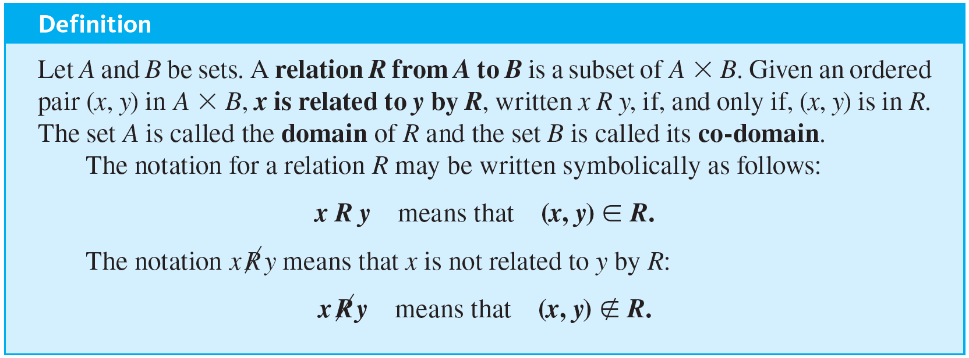
The Language of Relations and Functions

Slide 4

Example 1.3.1 – A Relation as a Subset
Let A = {1, 2} and B = {1, 2, 3} and define a relation R from A to B as follows: Given any (x, y) ∈ A × B,
a. State explicitly which ordered pairs are in A × B and which are in R.
b. Is 1 R 3? Is 2 R 3? Is 2 R 2?
c. What are the domain and co-domain of R?

Slide 5




Example 1.3.1 – Solution
a. A × B = {(1, 1), (1, 2), (1, 3), (2, 1), (2, 2), (2, 3)}. To determine explicitly the composition of R, examine each ordered pair in A × B to see whether its elements satisfy the defining condition for R.
(1, 1) ∈ R because
which is an integer.
(1, 2) ∉ R because
which is not an integer.
(1, 3) ∈ R because
which is an integer.
(2, 1) ∉ R because
which is not an integer.

Slide 6



Example 1.3.1 – Solution
continued
(2, 2) ∈ R because
which is an integer.
(2, 3) ∉ R because
which is not an integer.
Thus
R = {(1, 1), (1, 3), (2, 2)}
b. Yes, 1 R 3 because (1, 3) ∈ R.
No, 2
3 because (2, 3) ∉ R.
Yes, 2 R 2 because (2, 2) ∈ R.
c. The domain of R is {1, 2} and the co-domain is {1, 2, 3}.

Slide 7


Example 1.3.2 – The Circle Relation
Define a relation C from R to R as follows: For any (x, y) ∈ R × R,
(x, y) ∈ C means that
a. Is (1, 0) ∈ C? Is (0, 0) ∈ C? Is
∈ C? Is −2 C 0? Is 0 C (−1)? Is 1 C 1?
b. What are the domain and co-domain of C?
c. Draw a graph for C by plotting the points of C in the Cartesian plane.

Slide 8



Example 1.3.2 – Solution
a. Yes, (1, 0) ∈ C because
No, (0, 0) ∉ C because
Yes, 0 C (−1) because

Slide 9
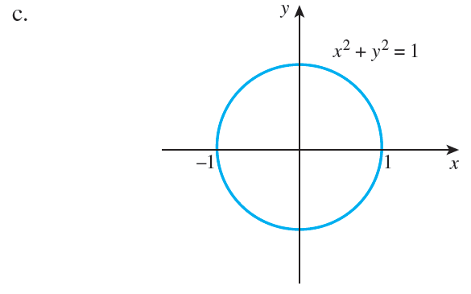
Example 1.3.2 – Solution
continued
b. The domain and co-domain of C are both R, the set of all real numbers.

Slide 10
Arrow Diagram of a Relation

Slide 11
Arrow Diagram of a Relation
Suppose R is a relation from a set A to a set B. The arrow diagram for R is obtained as follows:
1. Represent the elements of A as points in one region and the elements of B as points in another region.
2. For each x in A and y in B, draw an arrow from x to y if, and only if, x is related to y by R. Symbolically:
Draw an arrow from x to y
if, and only if, x R y
if, and only if, (x, y) ∈ R.

Slide 12
Example 1.3.3 – Arrow Diagrams of Relations
Let A = {1, 2, 3} and B = {1, 2, 3} and define relations S and T from A to B as follows:
For every (x, y) ∈ A × B,
(x, y) ∈ S means that x < y S is a “less than” relation.
T = {(2, 1), (2, 5)}.
Draw arrow diagrams for S and T.

Slide 13
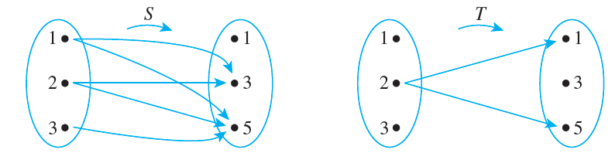
Example 1.3.3 – Solution
These example relations illustrate that it is possible to have several arrows coming out of the same element of A pointing in different directions. Also, it is quite possible to have an element of A that does not have an arrow coming out of it.

Slide 14
Functions

Slide 15
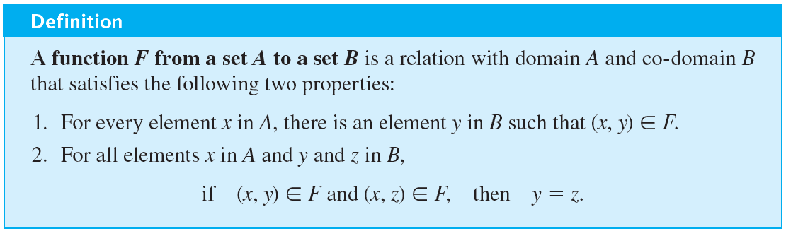
Functions

Slide 16
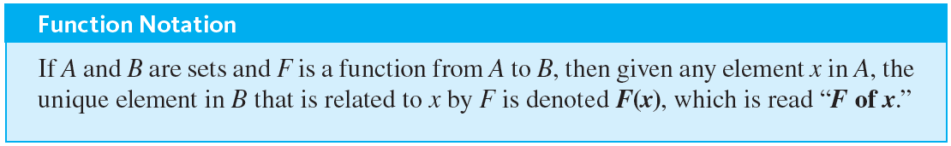
Functions
Properties (1) and (2) can be stated less formally as follows: A relation F from A to B is a function if, and only if:
1. Every element of A is the first element of an ordered pair of F.
2. No two distinct ordered pairs in F have the same first element.

Slide 17
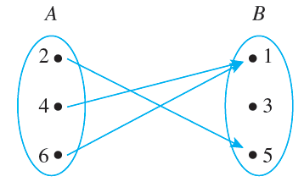
Example 1.3.4 – Functions and Relations on Finite Sets
Let A = {2, 4, 6} and B = {1, 3, 5}. Which of the relations R, S, and T defined below are functions from A to B?
a. R = {(2, 5), (4, 1), (4, 3), (6, 5)}
b. For every (x, y) ∈ A × B, (x, y) ∈ S means that y = x + 1.
c. T is defined by the arrow diagram

Slide 18
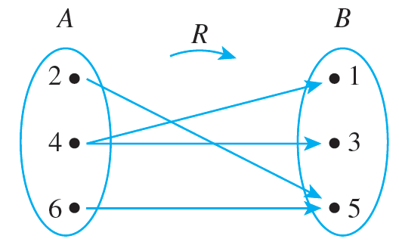
Example 1.3.4 – Solution
a. R is not a function because it does not satisfy property (2). The ordered pairs (4, 1) and (4, 3) have the same first element but different second elements. You can see this graphically if you draw the arrow diagram for R. There are two arrows coming out of 4: One points to 1 and the other points to 3.

Slide 19
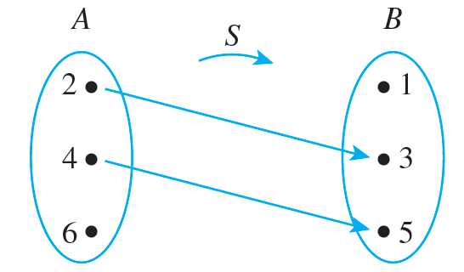
Example 1.3.4 – Solution
continued
b. S is not a function because it does not satisfy property (1). It is not true that every element of A is the first element of an ordered pair in S. For example, 6 ∈ A but there is no y in B such that y = 6 + 1 = 7. You can also see this graphically by drawing the arrow diagram for S.

Slide 20
Example 1.3.4 – Solution
continued
c. T is a function: Each element in {2, 4, 6} is related to some element in {1, 3, 5}, and no element in {2, 4, 6} is related to more than one element in {1, 3, 5}. When these properties are stated in terms of the arrow diagram, they become (1) there is an arrow coming out of each element of the domain, and (2) no element of the domain has more than one arrow coming out of it.
So you can write T(2) = 5, T(4) = 1, and T(6) = 1.

Slide 21

Example 1.3.5 – Functions and Relations on Sets of Strings
Let A = {a, b} and let S be the set of all strings over A.
a. Define a relation L from S to
as follows: For every string s in S and for every nonnegative integer n,
(s, n) ∈ L means that the length of s is n.
Observe that L is a function because every string in S has one and only one length. Find L(a b a a b a) and L(b b b).

Slide 22
Example 1.3.5 – Functions and Relations on Sets of Strings
continued
b. Define a relation C from S to S as follows: For all strings s and t in S,
(s, t) ∈ C means that t = a s,
where a s is the string obtained by appending a on the left of the characters in s. (C is called concatenation by a on the left.)

Slide 23
Example 1.3.5 – Functions and Relations on Sets of Strings
continued
Observe that C is a function because every string in S consists entirely of a’s and b’s and adding an additional a on the left creates a new strong that also consists of a’s and b’s and thus is also in S. Find C(a b a a b a) and C(b b b).

Slide 24
Example 1.3.5 – Solution
a. L(a b a a b a) = 6 and L(b b b) = 3
b. C(a b a a b a) = a a b a a b a and C(b b b) = a b b b

Slide 25
Function Machines

Slide 26
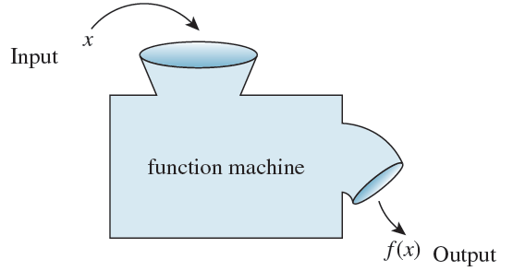
Function Machines
Another useful way to think of a function is as a machine. Suppose f is a function from X to Y and an input x of X is given. Imagine f to be a machine that processes x in a certain way to produce the output f(x). This is illustrated in Figure 1.3.1.
Figure 1.3.1

Slide 27



Example 1.3.6 – Functions Defined by Formulas
The squaring function f from R to R is defined by the formula
for every real number x. This means that no matter what real number input is substituted for x, the output of f will be the square of that number. This idea can be represented by writing
In other words, f sends each real number x to

Slide 28

Example 1.3.6 – Functions Defined by Formulas
continued
The successor function g from Z to Z is defined by the formula g(n) = n + 1.
Thus, no matter what integer is substituted for n, the output of g will be that number plus 1:
In other words, g sends each integer n to n + 1, or, symbolically, g: n → n + 1.

Slide 29

Example 1.3.6 – Functions Defined by Formulas
continued
An example of a constant function is the function h from Q to Z defined by the formula h(r) = 2 for all rational numbers r. This function sends each rational number r to 2. In other words, no matter what the input, the output is always 2:

Slide 30
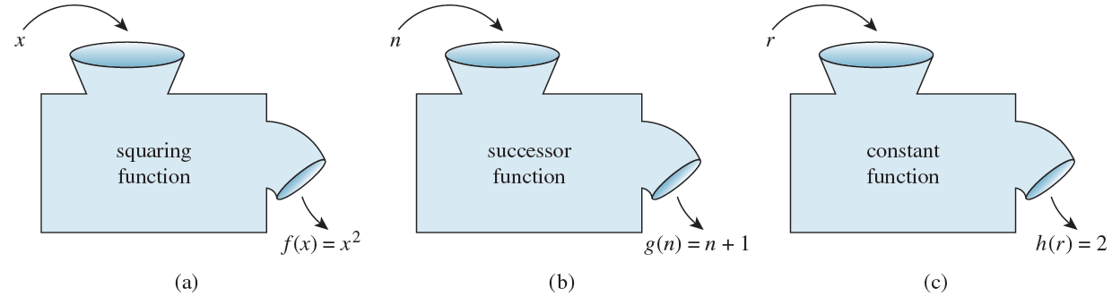
Example 1.3.6 – Functions Defined by Formulas
continued
The functions f, g, and h are represented by the function machines in Figure 1.3.2.
Figure 1.3.2

Slide 31
Function Machines
A function is an entity in its own right. It can be thought of as a certain relationship between sets or as an input/output machine that operates according to a certain rule.
This is the reason why a function is generally denoted by a single symbol or string of symbols, such as f, G, of log, or sin.

Slide 32
Function Machines
A relation is a subset of a Cartesian product and a function is a special kind of relation. Specifically, if f and g are functions from a set A to a set B, then
It follows that

Slide 33

Example 1.3.7 – Equality of Functions
Define functions f and g from R to R by the following formulas:
Does f = g?

Slide 34


Example 1.3.7 – Solution
Yes. Because the absolute value of any real number equals the square root of its square,
for all x ∈ R. Hence f = g.

